Slide 1


Kelly Cruttenden
Associate Athletic Director for Compliance
University at Buffalo
Division of Athletics

Slide 2
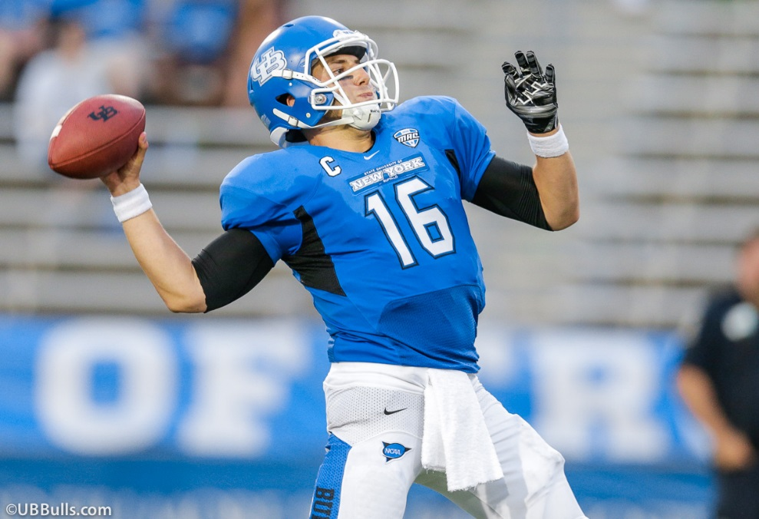
Eligibility
Recruiting
Scholarships

Slide 3
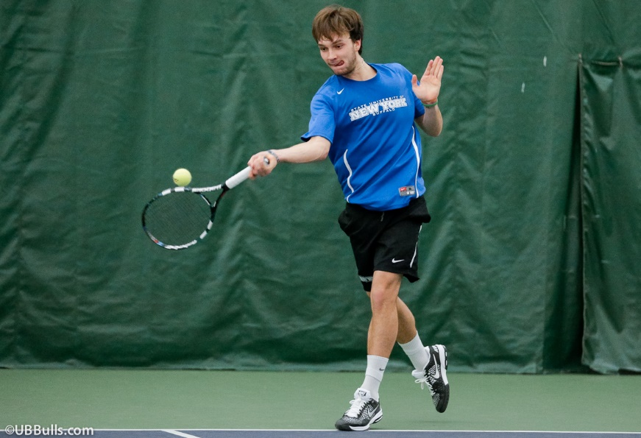
what is the difference between
DI and DII and DIII?
Level of athletic scholarships offered and number of sports offered
Time commitment
Level of play
Eligibility standards

Slide 4
DI scholarship limits
Sport | Men's | Women's
Baseball | 11.7 | –
Basketball | 13 | 15
Bowling | – | 5.0
Cross-country/track & field | 12.6 | 18.0
Field hockey | – | 12.0
Football | 85 (FBS) 63.0 (FCS) | –
Golf | 4.5 | 6.0
Gymnastics | 6.3 | 12
Ice hockey | 18.0 | 18.0
Lacrosse | 12.6 | 12.0
Rowing | – | 20.0
Rugby | – | 12.0
Sand volleyball | – | 6.0
Skiing | 6.3 | 7.0
Soccer | 9.9 | 14.0
Softball | – | 12.0
Swimming and diving | 9.9 | 14.0
Tennis | 4.5 | 8
Volleyball | 4.5 | 12
Water polo | 4.5 | 8.0
Wrestling | 9.9 | –

Slide 5
DII scholarship limits
NCAA Division II Men's Sports Scholarships
Baseball: 9
Basketball: 10
Cross Country/Track and Field: 12.6
Football: 36
Golf: 3.6
Gymnastics: 5.4
Ice Hockey: 13.5
Lacrosse: 10.8
Soccer: 9
Swimming and Diving: 8.1
Water Polo: 4.5
Wrestling: 9
NCAA Division II Scholarship Limits - Women
Basketball: 10
Cross Country/Track and Field: 12.6
Field Hockey: 6.3
Golf: 5.4
Gymnastics: 6
Ice Hockey: 18
Lacrosse: 9.9
Soccer: 9.9
Softball: 7.2
Squash: 9
Swimming and Diving: 8.1
Tennis: 6
Volleyball: 8
Water Polo: 8

Slide 6
what is the difference between
DI and DII and DIII?
Division I—offers highest level of athletic scholarships
Division II—offers athletic scholarships, but at a lower level than DI
Division III—cannot offer athletic scholarships

Slide 7
what is the difference between DI and DII and DIII?
DI—UB, Stony Brook, Albany, Binghamton, Niagara, Canisius, St. Bonaventure, Penn State, Michigan State, Duke, Stanford
DII—Daemen, PA state schools, CW Post, Dowling, Concordia, Dominican, Le Moyne, Mercy, NIT, Nyack, Pace, Queens, Saint Rose, St. Thomas Aquinas College
DIII-Cortland, Brockport, Buff State, St John Fisher, Nazareth, University of Rochester, Medaille, Ithaca, Keuka, D’Youville

Slide 8
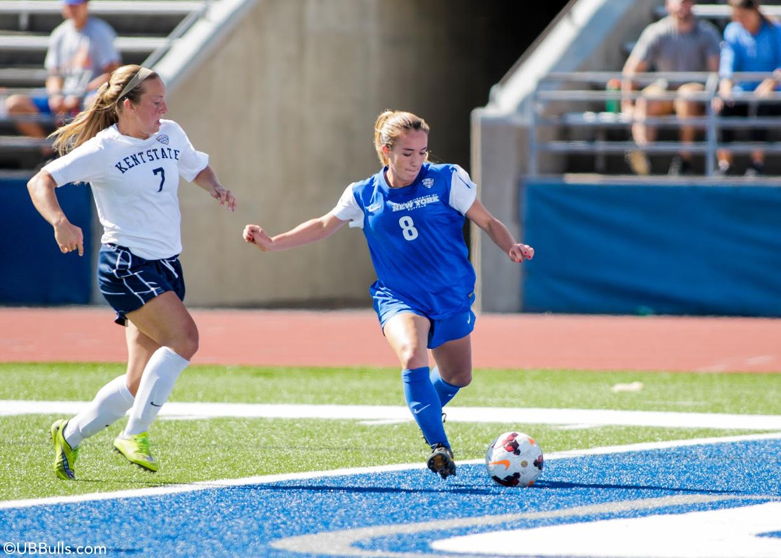
DIII Athletics
You live in a Division III “hotbed”….
Within three hours of the Buffalo area, there are countless excellent, affordable DIII schools with successful athletic programs and great academics.

Slide 9

NCAA department that determines freshmen initial eligibility for
Division I and II intercollegiate athletics.
What is the NCAA
Eligibility Center?

Slide 10
Division I eligibility
Graduation from high school
Minimum core course grade point average.
Minimum SAT or ACT score.
Completion of 16 core courses in grades 9-12—eight semesters of high school (one course after the completion of eight semesters)

Slide 11
Division I core course requirements
4 units of English
3 units of math (at Algebra I or higher)
2 units of science (one must have a lab)
2 units of social science
1 additional math, English or science
4 additional core courses—(language or any of the above)

Slide 12
GPA/test score sliding scale--Division I
To determine what GPA a student needs to be certified, the NCAA EC uses a sliding scale.
The higher the test score, the lower the GPA

Slide 13
Division II core course requirements
3 English
2 Math (Algebra 1 or higher)
2 science (1 w/lab)
3 additional math, English or science -
3 social science
4 additional core from any area and foreign language

Slide 14
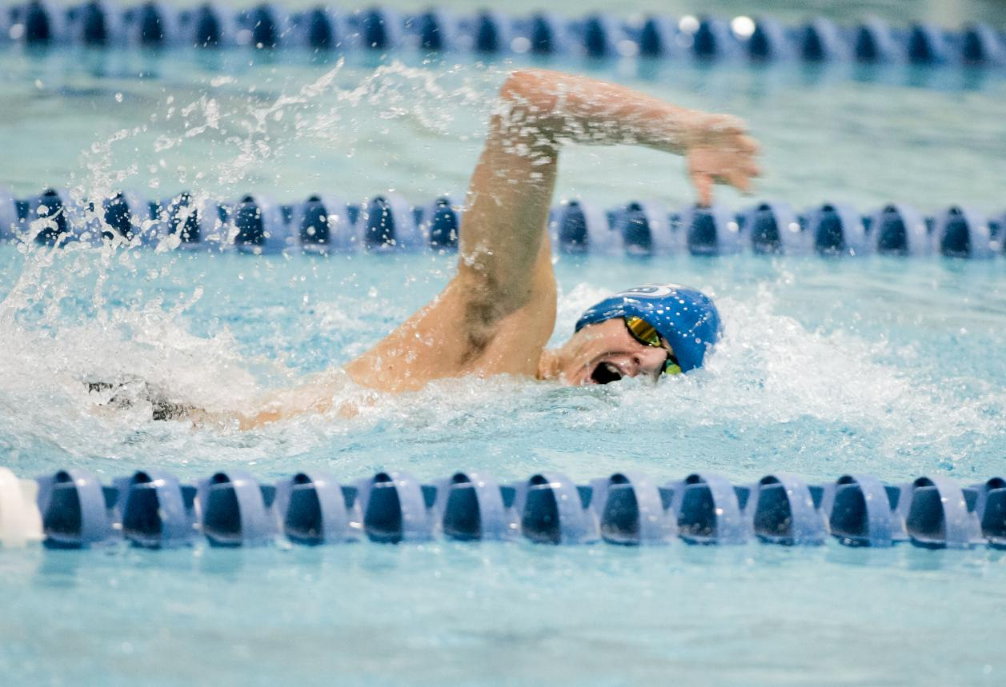
Division II requirements
Minimum 820 sum SAT score
Minimum 68 ACT sum score
Minimum 2.0 in all core courses

Slide 15
New DI standard:
Prospects also must successfully complete 10 of the 16 total required core courses before the start of their senior year in high school.
Seven of the 10 courses must be successfully completed in English, math and science.
For immediate access to competition, prospective student-athletes must achieve at least a 2.3 GPA and an increased sliding scale. For example, an SAT score of 1,000 requires a 2.5 high school core-course GPA for competition and a 2.0 high school core-course GPA for aid and practice.

Slide 16
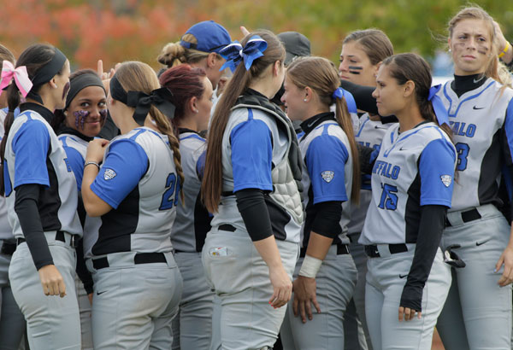
Division III/junior college requirements
NCAA Division III/junior college rules do not require students to register or be certified by the NCAA Eligibility Center.

Slide 17
Non-Qualifier
No Athletic Aid
No practice for 1 full academic year-YEAR IN RESIDENCE
No competition for 1 full academic year
*only get 3 seasons of DI competition

Slide 18
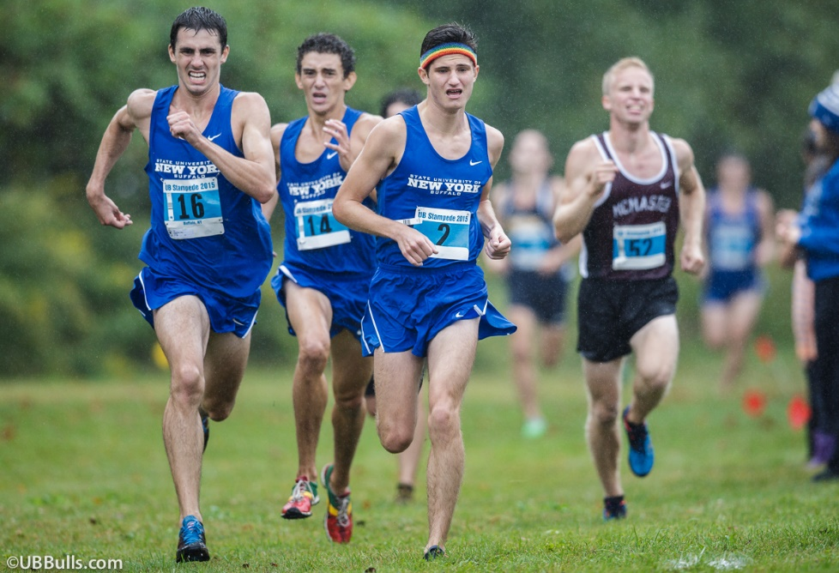
Ncaa approved
classes
List of your high school’s approved core courses
Available on the web
www.eligibilitycenter.org

Slide 19
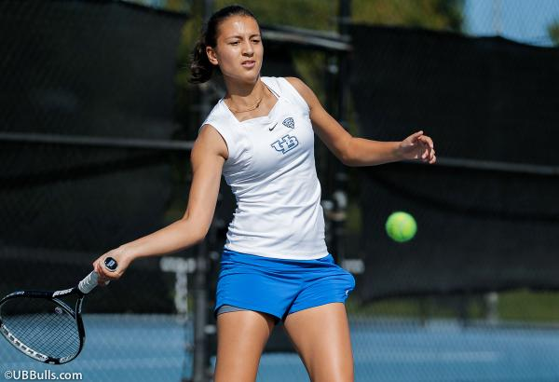
Who should
register?
Any student who plans on
attending a Division I
or II institution and
competing in
intercollegiate athletics
*Recommend for junior college as well

Slide 20
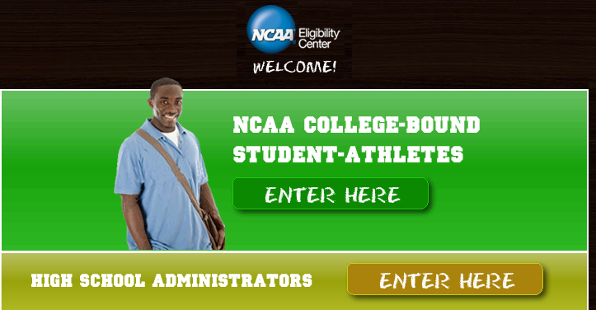
Online
registration
start here!

Slide 21
When to register
Register any time you’d like, but no later than the beginning of your senior year.
Eligibility Center will start reviewing your transcripts after *four semesters of high school.

Slide 22
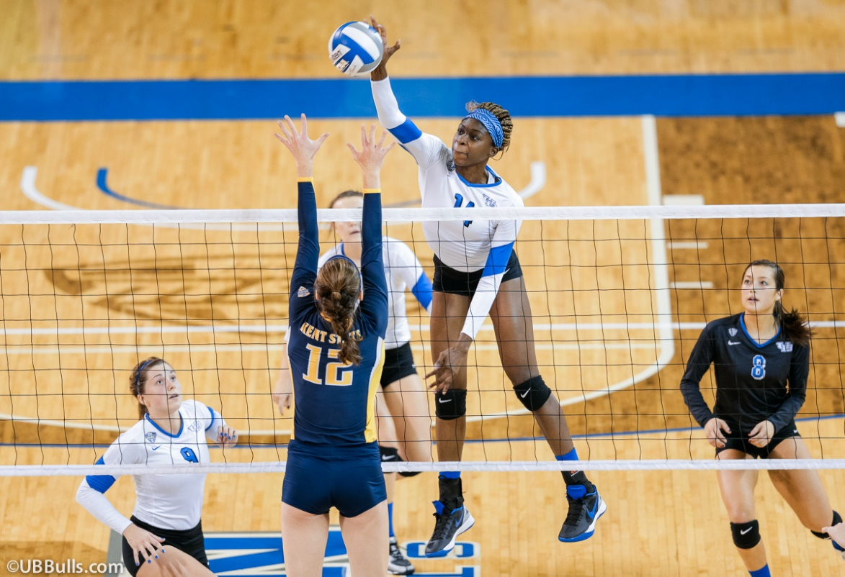
DI Recruiting 101

Slide 23
DI Recruiting 101
Phone calls and text messages from coaches can start September 1 of your junior year and are unlimited(football, track, swimming and basketball have some exceptions)—STUDENTS CAN CALL COACHES ANYTIME
Emails, recruiting letters, media guides, notecards, from the athletics department start September 1 of junior year.
Camp brochures, questionnaires, and admissions publications and NCAA educational information can be mailed to you at any time.

Slide 24
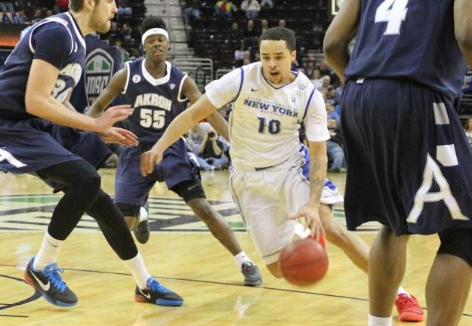
recruiting
quick
tips
BE REALISTIC…what level are you?
DI? II? III? Junior college? What do YOU want to do?
Online athletics questionnaires-fill them out! Most go right to the coaches.

Slide 25
stay in touch
Send schedules, highlight video, and game video…do you have online video? Email the links.
Email/text coaches—most are very busy and travel a lot.
Read team blogs and get on the team or coach’s twitter page—this will give you an inside look at the program.

Slide 26
make calls
Stay in contact—respond to emails, voicemails and texts.
Attend summer athletics camps at your top schools
Recruit yourself—the number of kids looking for scholarships is EXPONENTIALLY higher than the amount of scholarships available

Slide 27
take visits
Plan visits (unofficial and official)—you get 5 “official” visits your senior year where college coaches can pay for you to visit. (DI)
Unofficial visits, where you pay all of your expenses, are unlimited and can be taken at ANY TIME (with a few exceptions).
Let the coaches know you’re coming to campus for a visit—set up a tour, watch a practice, meet faculty, talk to other athletes

Slide 28
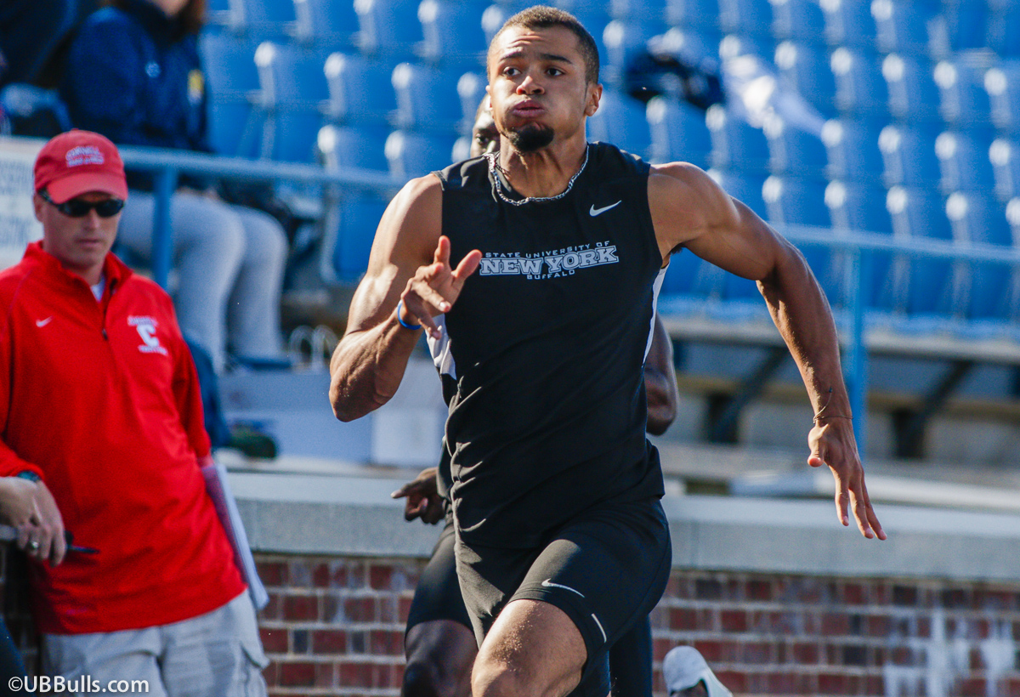
think about it...
Pick a school for the major, the location, the career/internship opportunities, the programs, the clubs, the faculty, the class size, the opportunity for financial aid----what’s the best fit for you?
Close to home? Far? Big? Small? Public? Private?

Slide 29
Scholarships:
Contracts that can be issued for 1-5 years
may be “full” (tuition, fees, room, board and books); or Cost of Attendance**new
they may be “partial” or a percentage of a full scholarship (.5 or .75); or
they may be issued as a dollar amount ($5000) or
they may be issued as “tuition” or “room and board”

Slide 30
Scholarships:
Can be taken away DURING the school year for 1) ineligibility 2) quitting OR 3) disciplinary issues
Cannot be taken away DURING the school year for injury/performance
Can be non-renewed at the end of the year (or end of term of agreement), in writing, prior to July 1 for ANY reason
In either case, athletes always have a right to a hearing of staff outside of Athletics.

Slide 31
numbers
Men's Basketball
Less than one in 35, or approximately 3.0 percent, of high school senior boys playing interscholastic basketball will go on to play men's basketball at a NCAA member institution.
Women's Basketball
About 3.3 percent, or approximately three in 100, of high school senior girls interscholastic basketball players will go on to play women's basketball at a NCAA member institution.

Slide 32
numbers
Football
About 5.7 percent, or approximately one in 17, of all high school senior boys playing interscholastic football will go on to play football at a NCAA member institution.
Baseball
About 3 in 50, or 6.1% of all high school boys playing baseball will go on to play baseball at a NCAA member institution.

Slide 33
numbers
Division I men’s soccer programs ~ 200 (about 5000 men)
NCAA maximum scholarships
for men’s soccer = 9.9 (these can be split up amongst the team)
Number of high school boys playing soccer = almost 360,000

Slide 34
do your homework
Ask questions to the college coaches…
How many other athletes are they recruiting at your position?
How many athletes are already on the team in my position?
Will I play as a freshman or will I “redshirt”?
How much scholarship money is available? Are there other grants or scholarships available?

Slide 35
do your homework
Ask questions to the college coaches…
Will I go home for the summer or does the team stay and train and take classes?
Do I go home for winter break/spring break or will I be on campus practicing?
What time does the team practice?
Will I be required to attend study hall?

Slide 36

admissions
High school grades MATTER!!
Every school has different admissions standards…find out what they are for your top choices.
Don’t think “if the coach wants me to play, then he/she will get me in to school”. This is NOT true at most schools.

Slide 37
apply early!
Apply to your top choices EARLY--$$ is first come first serve at a lot of schools. Make sure your high school sends your transcripts and test scores to the Admissions Office of the schools to which you’re applying. Pay attention to any deadlines or other admissions requirements.
The difference in applying in the fall and applying in the spring can be thousands of $$ in academic scholarships or other grants.

Slide 38
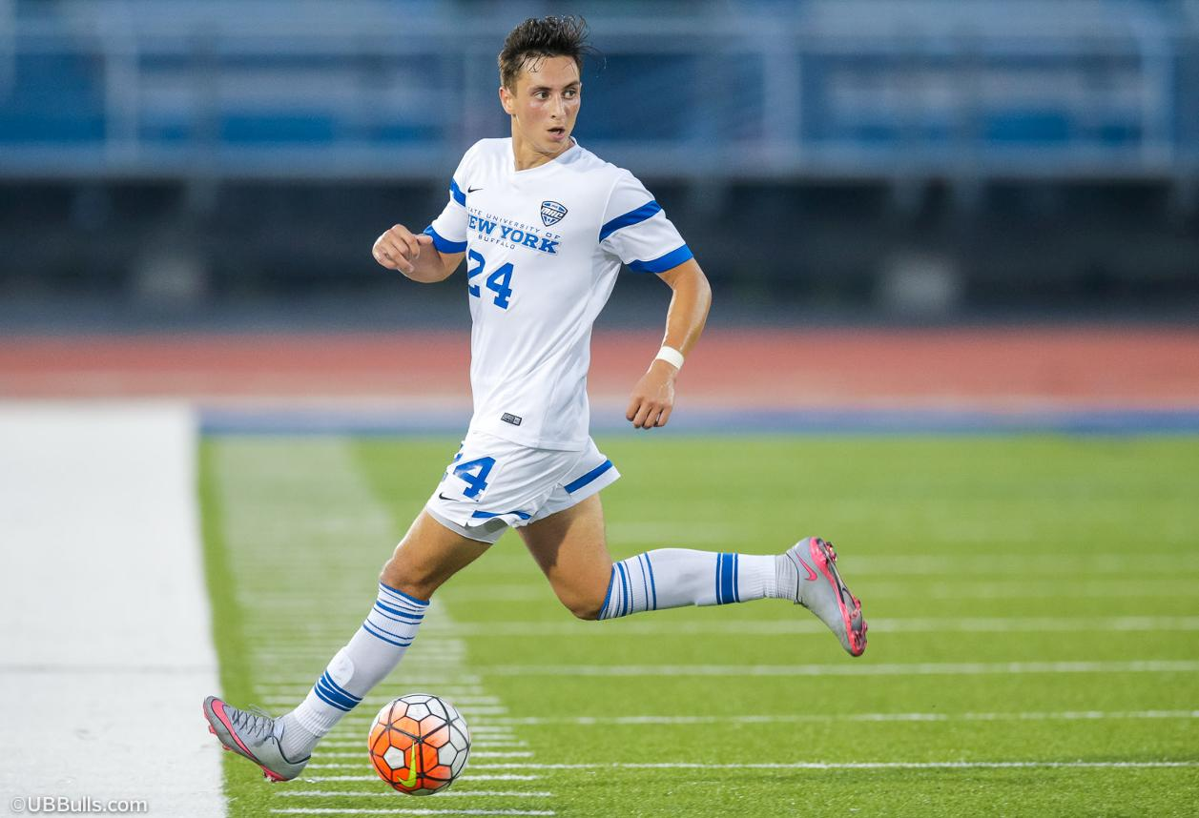
questions?

